Slide 1
Yogesh Kulkarni Principal Architect – CTO Office
Explainable AI

Slide 2
What we do in AIML team …
Notes:
One of the Apps we are building..

Slide 3
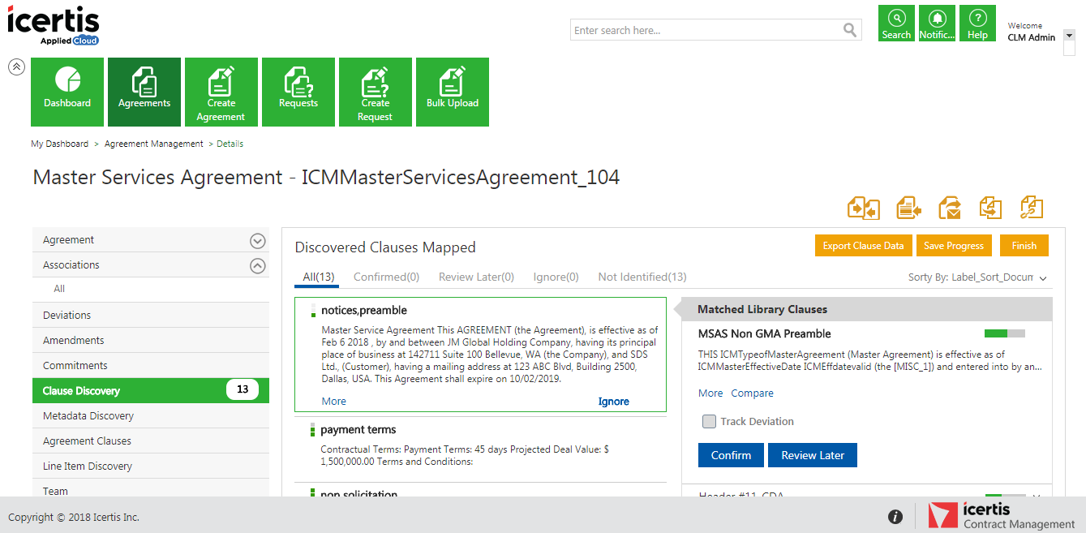
ICM DiscoverAI App
AI Powered NLP & Semantics Driven Clause Discovery, Deviations and Verifications
Powerful capabilities:
Image/PDF Conversion
Clause and Attribute Discovery
Accurate Clause Matching
Deviation Tracking
Attribute Verification
Driven by NLP & Machine Learning

Slide 4
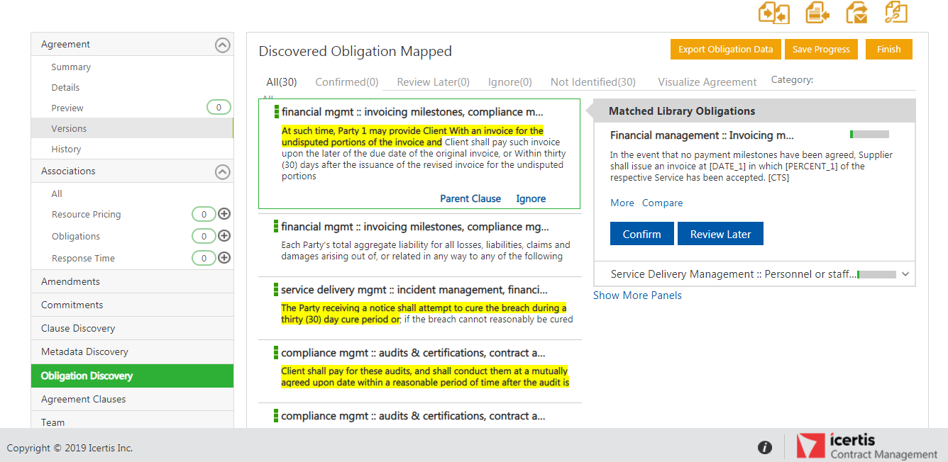
ICM Obligation Management (AI Powered) App
AI Powered Obligations discovery and insights into your contracts
Powerful capabilities:
Easy Obligation Management
Extract obligations & Categorize them with Customer Taxonomy
Extract key meta data from discovered obligations, automatically
Automate obligations assignment to both internal and external users
Take direct action based on intelligent insights
Reduced risks by complying with contractual obligations

Slide 5
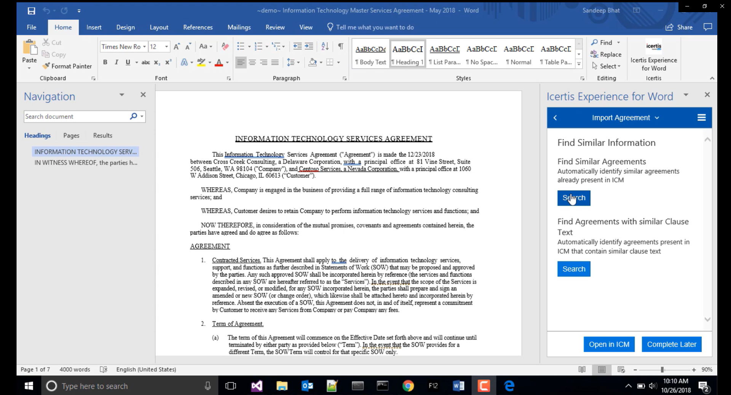
ICM NegotiateAI App
AI-powered insights to optimize contract negotiation, reduce risk, and negotiate better outcomes
Powerful capabilities:
Automated contract discovery
NLP & Semantics powered extractions
Finds similar contract and clauses
Highlight clause deviations to ensure compliance
Powerful AI-infused negotiations
Familiar Microsoft Experiences
Efficient Business Outcomes

Slide 6
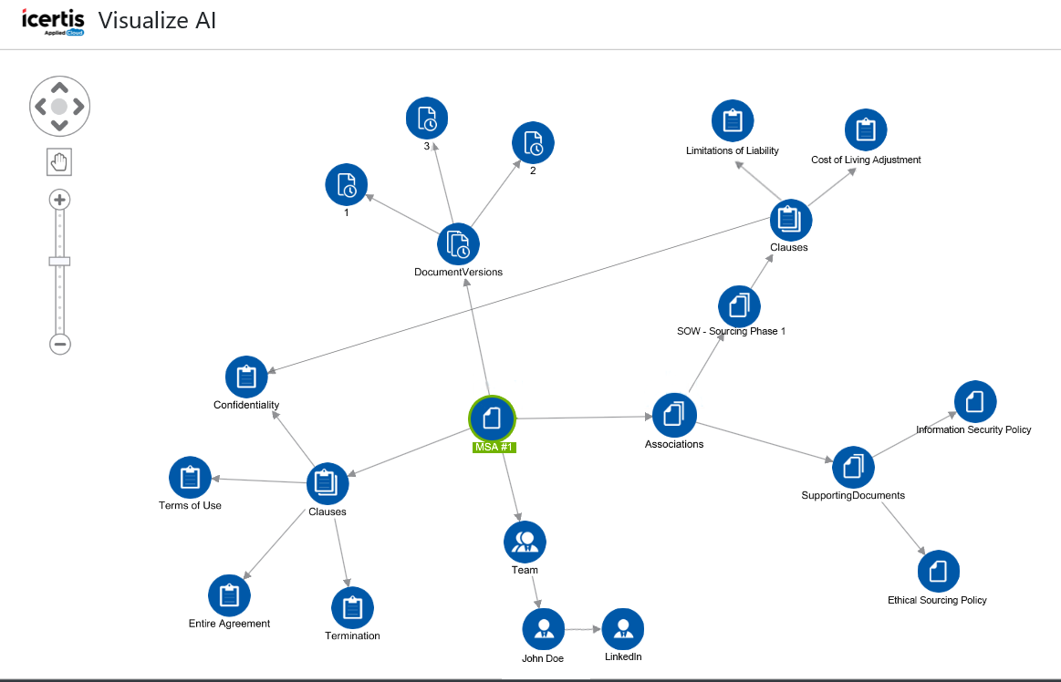
ICM VisualizeAI App
Visualize complex contract structures, relationships and connections
Powerful capabilities:
Unified view of Contracting Across the Organization
Auto discover dependencies, structures associations & relationships
Unlock hidden contract insights, connections and get contextual views
Link to external data sources
Unprecedented insights into your entire contract portfolio
Take direct actions based on such intelligent insights

Slide 7
Overall Data Flow of Discover/Digitize AI
Load Doc
Clause Split
Clause Classification
Metadata Extraction
Report Generation

Slide 8
A Sample Digitization Project …
Number of Contracts to be Digitized : 60K
Number of Clauses to be discovered : 32 (“Term”, “Warranty”, …)
Number of Attributes to be discovered: 12 (“Effective Date”, “Contract Value”,…)
Time : 3 months

Slide 9
Steps …
Build AI Engine using annotated samples to extract attributes
Show results of training to the Customer and get approval
Start extractions (production) for all the contracts, in batches …

Slide 10

Halfway through the production …
Icertis confidential
Notes:
What is customer ask?
Who is the user?

Slide 11
A sample dialog
Customer: The extractions are looking ok, but…
AIML team: But??
Customer: Why are you digitizing these ‘DELLA’ contracts?
AIML team: Meaning?
Customer: You should not digitize contracts having ‘DELLA Corporation’ in the footer.
AIML team: But you never told us. No mention of any such rules in SOW also..
Customer: We are just asking you to NOT process these, not adding to your work/scope!!
AIML team: But….
Customer: Shouldn’t be difficult, right? AI will find out…

Slide 12
(we keep hearing…)
AI will find out!!
Icertis confidential
Notes:
What is customer ask?
Who is the user?

Slide 13
(sometimes…)
AI should find out!!
Icertis confidential
Notes:
What is customer ask?
Who is the user?

Slide 14
(what if…)
AI can not find out!!
Icertis confidential
Notes:
What is customer ask?
Who is the user?

Slide 15
(and worse if …)
AI finds it and finds it wrongly!!
Icertis confidential
Notes:
What is customer ask?
Who is the user?

Slide 16
(bottom line… we need to understand that)
AI is not Magic!!
Icertis confidential
Notes:
What is customer ask?
Who is the user?

Slide 17
(But still, you need to explain me)
Why AI gave this result!!
Icertis confidential
Notes:
What is customer ask?
Who is the user?

Slide 18
(that’s)
Explainable AI
Icertis confidential
Notes:
What is customer ask?
Who is the user?

Slide 19
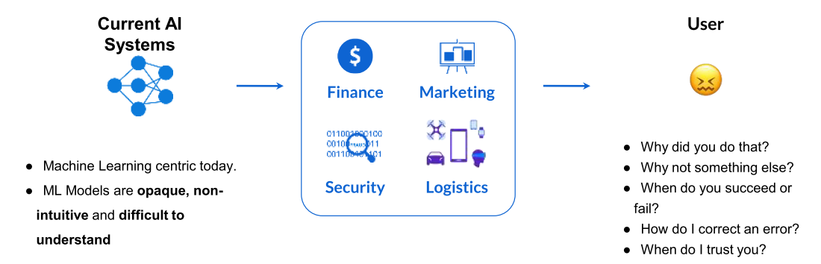
Need for Explainable AI
Explainable AI is essential for customers to understand and trust the decisions by AI.
(Explainable AI in Industry, KDD 2019 Tutorial,Sahin Cem Geyik, Krishnaram Kenthapadi & Varun Mithal )
Icertis confidential
Notes:
What is customer ask?
Who is the user?

Slide 20
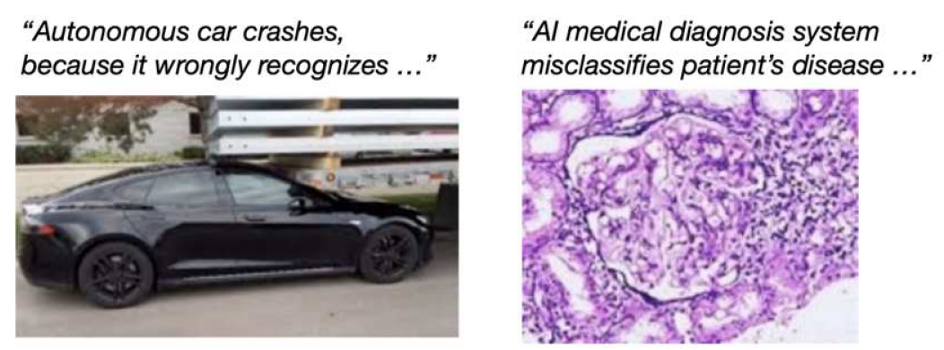
Wrong decisions: Costly and dangerous
(Credit: Samek, Binder, Tutorial on Interpretable ML, MICCAI’18)
Icertis confidential
Notes:
What is customer ask?
Who is the user?

Slide 21
AI as Black Box
Why did the AI system do that?
Why didn’t the AI system do something else?
When did the AI system succeed?
When did the AI system fail?
When does the AI system give enough confidence in the decision that you can trust it?
How can the AI system correct an error?
Explainable AI (XAI) – A Perspective, Saurabh Kaushik

Slide 22
Explainable AI

Slide 23
Three Key Pillars of Explainable AI
Reasonable AI: The ability to understand the reasoning behind each individual prediction
Traceable AI: The ability to trace prediction process from algorithm to data.
Understandable AI: The ability to fully understand the AI decision-making is based
Explainable AI (XAI) – A Perspective, Saurabh Kaushik

Slide 24
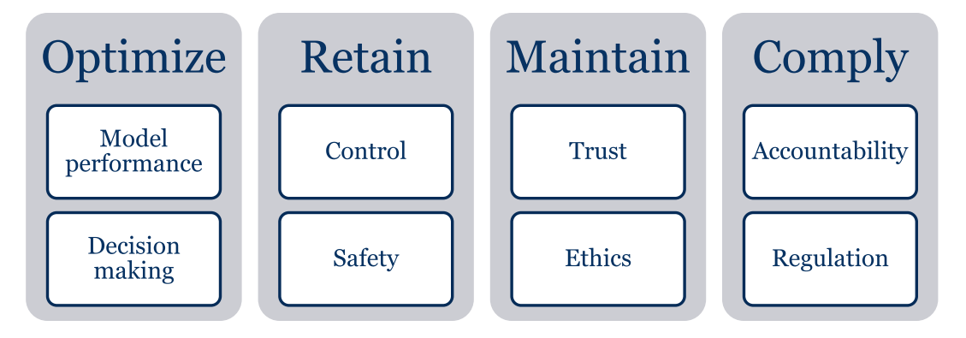
Business Benefits
“Explainable AI is Responsible AI”
“Right to Explanation” – GDPR
Explainable AI (XAI) – A Perspective, Saurabh Kaushik

Slide 25
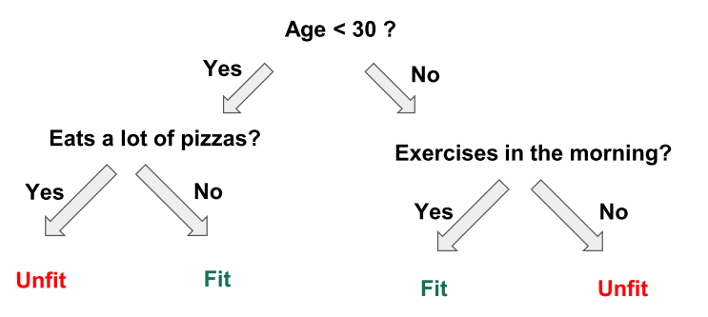
Achieving Explainable AI
Prediction explanations
Important features
Features weights
Decision tree plotting
Build an interpretable model using libraries like LIME, SHAP, etc.
Explainable AI in Industry, KDD 2019 Tutorial,Sahin Cem Geyik, Krishnaram Kenthapadi & Varun Mithal

Slide 26
“Interpretability is the degree to which a human can
understand the cause of a decision.”
(Miller, Tim. 2017. “Explanation in Artificial Intelligence: Insights from the Social Sciences.”)
Icertis confidential
Notes:
What is customer ask?
Who is the user?

Slide 27
So, What (exactly) is AI?

Slide 28
(typical understanding)
If Machines show intelligence, like Humans
that’s AI
Icertis confidential
Notes:
What is customer ask?
Who is the user?

Slide 29
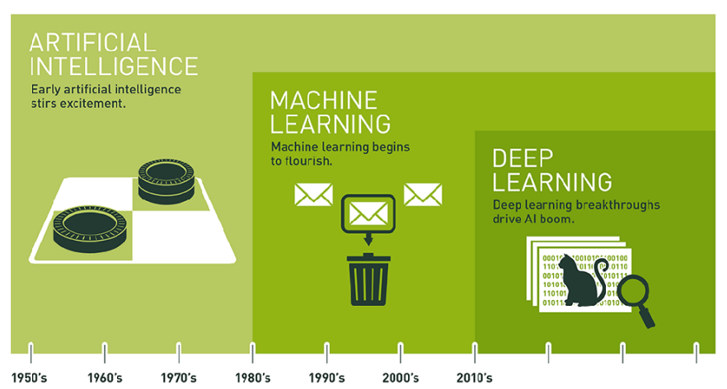

Slide 30
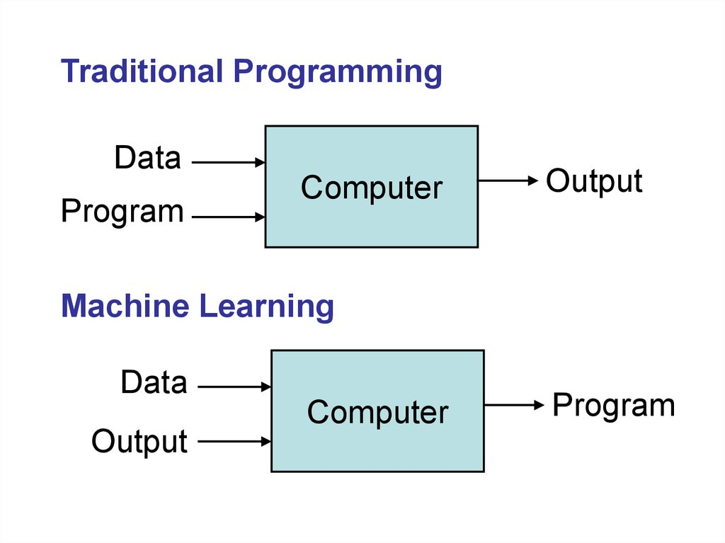

Slide 31
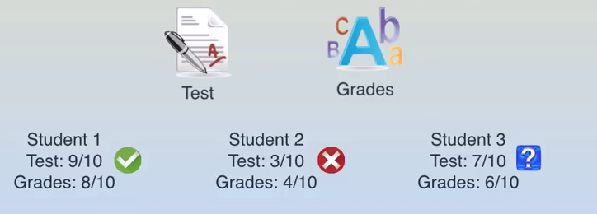

Slide 32
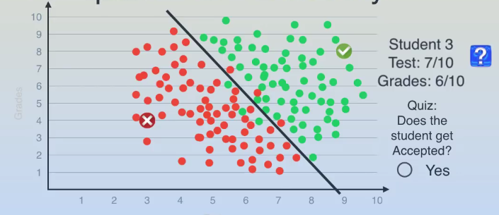

Slide 33
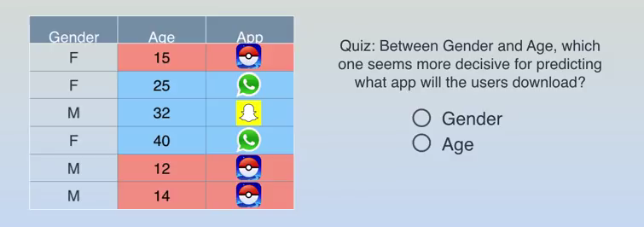

Slide 34
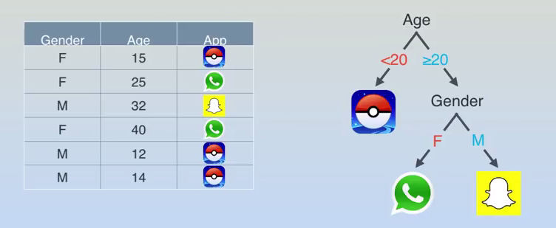

Slide 35
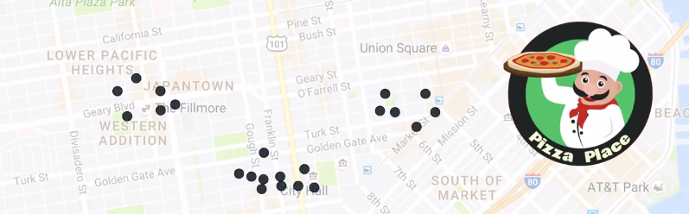

Slide 36
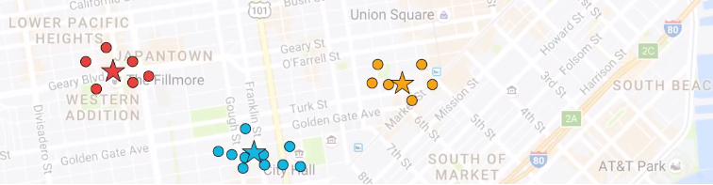

Slide 37
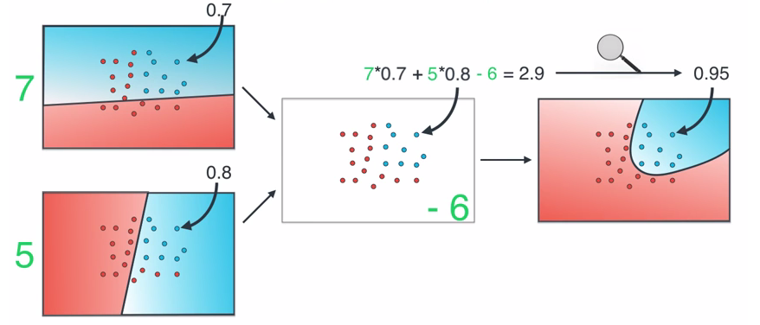

Slide 38
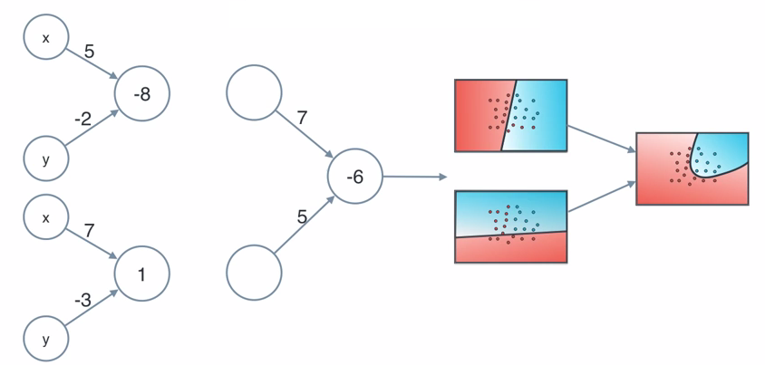

Slide 39
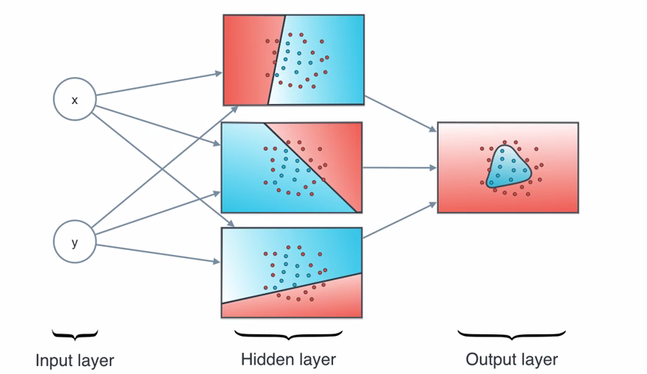

Slide 40
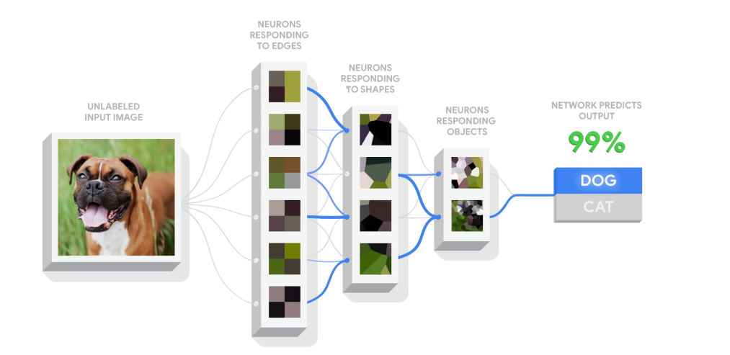

Slide 41
Explain-ability of AI Algorithms
Regression – Multinomial Equation can be messy
Random Forrest – Multiple Tree and their Data Set and Voting
SVM – Kernel and Data Partition effect on Feature
K Mean – Nature of Centroid don’t describe cluster well.
NN – Hidden Nodes and their way of creating features
Explainable AI (XAI) – A Perspective, Saurabh Kaushik

Slide 42
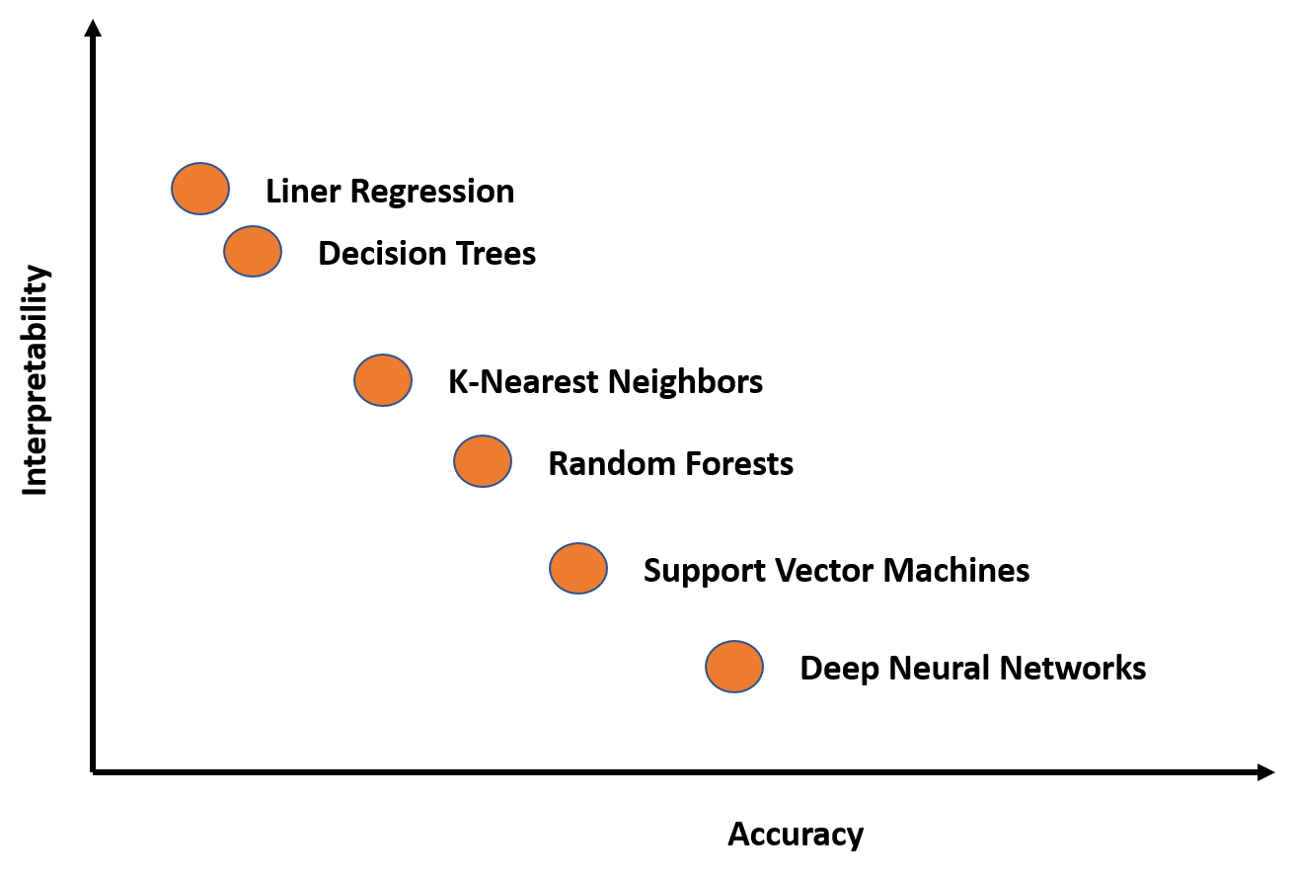
But…
(Application of artificial intelligence in gastroenterology, April 2019,World Journal of Gastroenterology 25(14):1666-1683)

Slide 43
So…Finally

Slide 44
AI is just a set of algorithms,
which (predominantly ) work given Inputs as well as Outputs
Icertis confidential
Notes:
What is customer ask?
Who is the user?

Slide 45
For example: to find out clause “Term”…
Need to supply AI algorithm with 100s/1000s of “Term” clause samples
Gets trained on patterns, word frequencies, context words
Stores this information as ‘model’
Can be used to classify unseen clause, whether “Term” or not.
Icertis confidential
Notes:
What is customer ask?
Who is the user?

Slide 46
Quiz
If you want to find something “new”, what would be needed?
Icertis confidential
Notes:
What is customer ask?
Who is the user?

Slide 47
Summary
AI-ML-DL approaches are non-deterministic (but <>?)
For good results, need good annotated data and lots of it
Annotations need to be perfect (“Gold”), else Garbage-In-<??-<??>
Data should cover all possible variations
AI-ML-DL just fits the data, but just that, it does it automatically!!
ML has better explain-ability than DL (why?)
Icertis confidential
Notes:
What is customer ask?
Who is the user?

Slide 48
Btw, thoughts to ponder on…
‘AI is biased’
‘Explainable AI’ is to understand how/why it is biased
But then…
Human are biased too…
‘Explainable Humans’… the next topic?
Icertis confidential
Notes:
What is customer ask?
Who is the user?

